Slide 1


PUBLISHING AND GETTING READ : Understanding the Secrets to Impact Factor Publications by Researchers
Chidi Nzeadibe
University of Nigeria, 410001 Nsukka, Nigeria
Email: chidi.nzeadibe@unn.edu.ng

Slide 2
Yes, I Can Do It!
Publishing is a crucial, but sometimes daunting and unexplained, part of academic life.
All academics are supposed to do it, but there are few formal guidelines about how best it should be done.
Many of us discover how to publish by trial and error or through the mentoring and support of colleagues.
Publishing and academic landscapes also change, presenting new challenges to established academics

Slide 3
So, why publish?
Disseminating your research finding
Improve chance of promotion, lecture tenure position etc
More likely to obtain research grants, or extension of research funding or postdoc position
Enhancing your scholarly reputation
Desire to advance scientific thought or improve health outcomes
Contributing to public policy
Bragging rights of being identified as author of some important papers
Consultancies, External Examinations, Editorial Boards, Invitations to Review & Expert Panels
Recognition at national & international levels
Expand professional contacts - locally and internationally

Slide 4
A strong publication record – and clear future publication plans – is a vital part of an academic curriculum vitae.

Slide 5
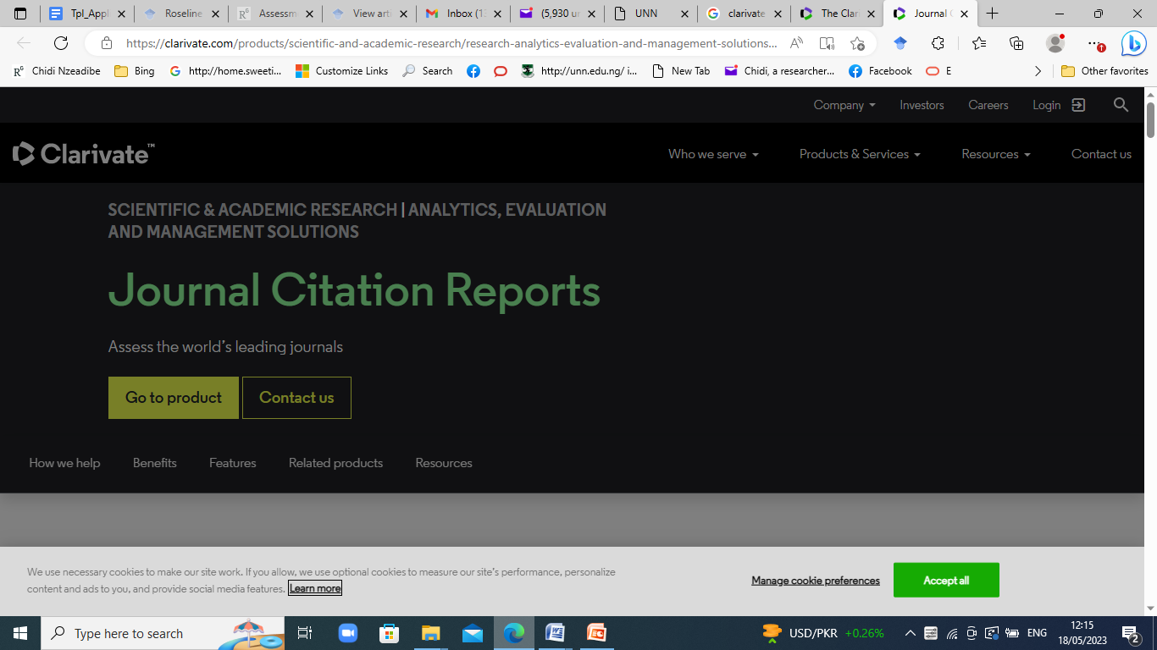

Slide 6
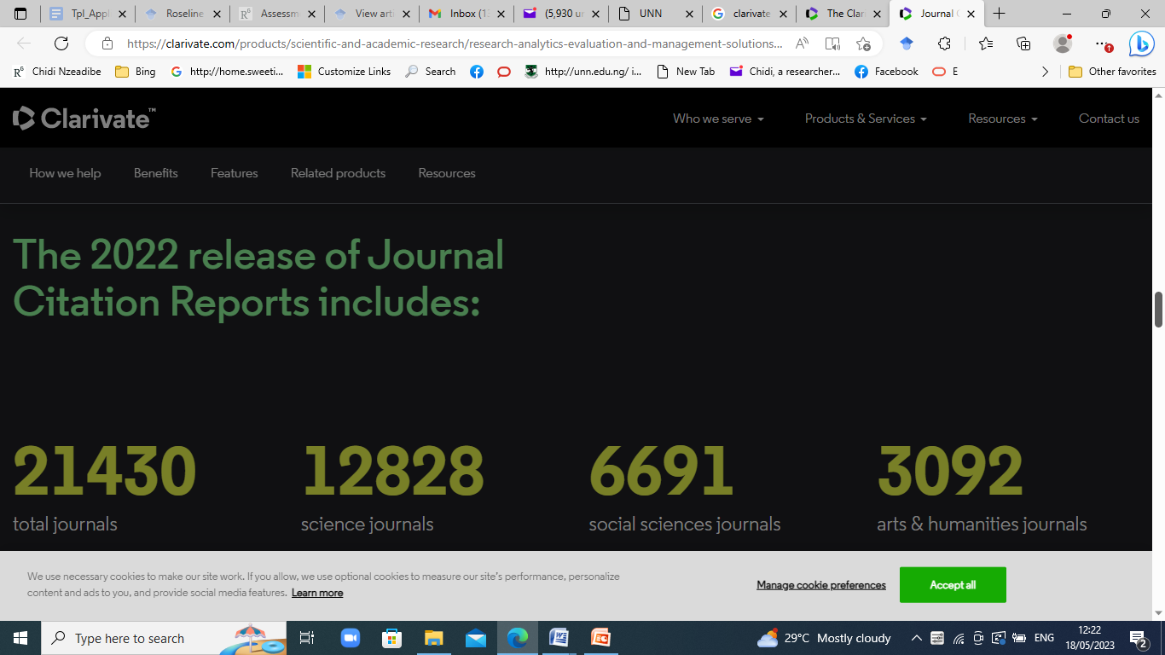

Slide 7
Clarivate Analytics
Clarivate Analytics was formerly known as The Institute for Scientific Information (ISI).
Journal Citation Reports (JCR)³ in 1975 as part of the SCI and the Social Sciences Citation Index (SSCI).
JCR provides quantitative tools for ranking, evaluating, categorizing, and comparing journals

Slide 8
The annual JCR impact factor is a ratio between citations and recent citable items published
Thus, the impact factor of a journal is calculated by dividing the number of current year citations to the source items published in that journal during the previous two years

Slide 9
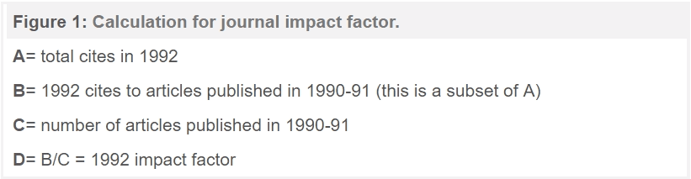

Slide 10
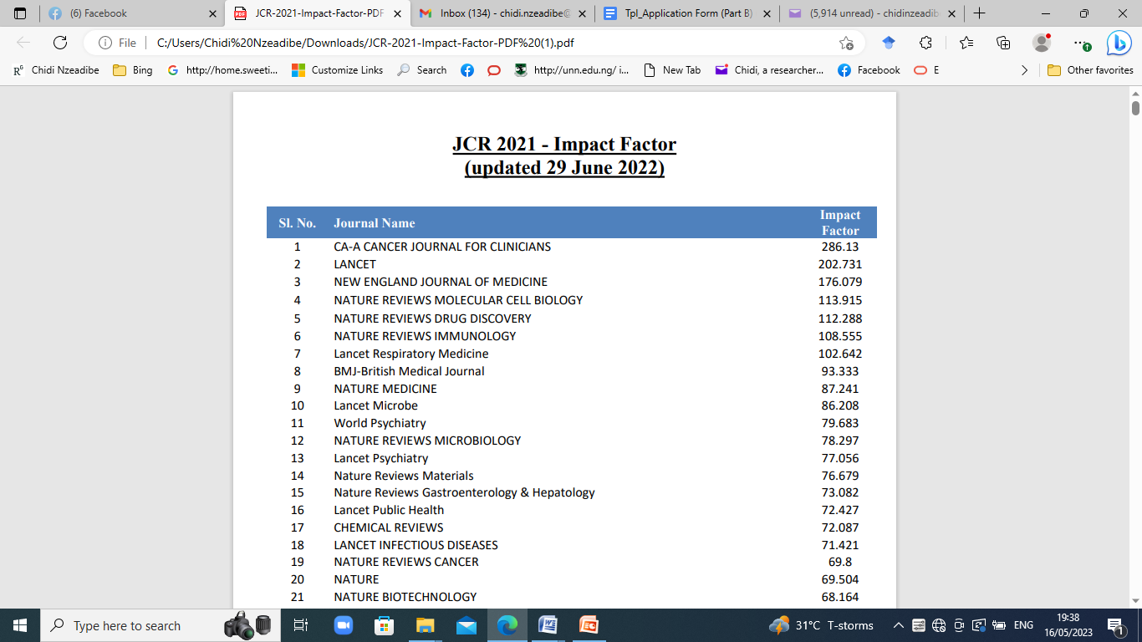

Slide 11
Citation metrics such as Impact Factor are based on the assumption that when an article is cited by another academic, it has had an impact on their research.

Slide 12
Institutional benefits
Academic prestige and standing eg. Universities ranking- THE, SCOPUS etc
Measure of academic productivity
May be linked to university funding

Slide 13
Research Assessment
Academic publishing is also central in a variety of different schemes of research assessment (including, in the UK, the Research Excellence Framework).
Where and in what form your work is published matters
In 2015-2016 in UNN, publishing in Thomson Reuters Impact Factor Journals attracts cash Reward and Recognition
So, we need to take publishing in IF Journals seriously!

Slide 14
Where to publish
How do you identify journals in which to publish your research?
This decision is based on a range of factors such as :
the prestige of the journal (often measured by the Impact Factor)
the subject covered in the journal
the type and length of article published in the journal
readership of the journal (or who you wish to engage with)

Slide 15
the turnaround time between submission and publication
your preference on whether to publish in a subscription or open access journal and stipulations that may be mandated by funders
The geographical representation and diversity of the editorial board. Authors will consider whether the diversity of the editors reflects the stated international nature of the journal.

Slide 16
It is also important for authors to feel that their research area is reflected in the editorial board.
journals identify their prestigious nature and their quality by their ranking according to journal impact factor

Slide 17
Who do you wish to engage with?
Some journals are very specialist and others more general in remit.
Articles published in discipline or even sub-disciplinary journals often focus on a more narrow set of debates and take more background information for granted.
Publishing in a general subject journal can raise your profile and demonstrate your ability to engage with wide ranging debates.

Slide 18
However, articles in more specialist journals may be more helpful in establishing your expertise and research credentials.
When dealing with more specialist journals it is important to check that your material maps on to the advertised remit of the journal.
If your piece does not fit, save yourself time and energy and submit somewhere else. If you are unsure, most editors are happy to advise about suitability on receipt of an abstract.
If you are not in a hurry to have an article accepted you might try submitting to a more prestigious and selective journal.

Slide 19
PhD alone isn’t enough!
Possession of a PhD alone isn’t enough
You don’t just pull your thesis off the shelf and hope to publish from it
Additional work is needed! E.g update of literature
If you have a PhD and find it difficult to write a paper for good Journal, then a question mark is on the quality of your PhD.

Slide 20
Conference presentation is key!
Before submitting your manuscript to a journal:
Present it first at a conference preferably int’l
Obtain critical comments from participants
Some participants are also Editors of your target journals
Interact with these Editors and get First-hand advice
Inform them that you are considering submitting to their journal
Consider seriously the comments and revise the manuscript accordingly

Slide 21
Great Global Appetite for COVID-19 publications
Take the opportunity in the adversity - All disciplines have something to offer!
Covid-19: Opportunity for global visibility!
Rapid turn around time
How many of you have published articles on Covid-19?
Why so? How so? (Google forms, review articles & systematic reviews etc
Liberal methods &Short turn around time
Increased global interest
Special issues on Covid-19

Slide 22
Sample of Covid-19 publications from FSS
1. Onyishi et al (2020) COVID-19 Pandemic and Informal Urban Governance in Africa: A Political Economy Perspective. https://journals.sagepub.com/doi/full/10.1177/0021909620960163
2. Nzeadibe & Ejike-Alieji (2020) Solid waste management during Covid-19 pandemic: policy gaps and prospects for inclusive waste governance in Nigeria. https://www.tandfonline.com/doi/full/10.1080/13549839.2020.1782357
3. Ezeibe et al (2020) Political distrust and the spread of COVID-19 in Nigeria. https://www.tandfonline.com/doi/abs/10.1080/17441692.2020.1828987
4. Ajibo (2020) Effect of Covid-19 on Nigerian Socio-economic Well-being, Health Sector Pandemic Preparedness and the Role of Nigerian Social Workers in the War Against Covid-19. Social Work in Public Health. https://www.tandfonline.com/doi/abs/10.1080/19371918.2020.1806168
5. Onalu et al (2020). COVID-19 response and social work education in Nigeria: matters arising. Social Work Education. https://www.tandfonline.com/doi/full/10.1080/02615479.2020.1825663
6. Iwuoha et al (2020) Glocalization of COVID-19 responses and management of the pandemic in Africa. https://www.tandfonline.com/doi/abs/10.1080/13549839.2020.1802410
7. Chukwuorji, J. C., & Iorfa, S. K. (2020). Commentary on the coronavirus pandemic: Nigeria. Psychological Trauma: Theory, Research, Practice, and Policy, 12(S1), S188-S190. http://dx.doi.org/10.1037/tra0000786
8. Nche, G.C (2020). Why we still shake hands: How beliefs inform young people's socializing choices amidst Covid-19 in Nigeria. SageSubmissions

Slide 23
Steps to publishing in IF Journals
At the stage of manuscript preparation:
Read and understand the advertised remit of journal –i.e it’s scope
Understand the editors’/reviewers’ psychology
Adhere strictly to instructions for authors, word limit, journal style etc
Ensure data integrity & currency of literature
Download and review sample articles from target journal

Slide 24
Where relevant, cite articles from target journal
Identify a clear gap in knowledge and be innovative
Adequately explain novel methodologies
Use clear figures and illustrations
Cross-check all references and web links
Utilize the services of a professional copy/language editor
Run similarity checks and ensure that your submission complies with COPE guidelines

Slide 25
Familiarize yourself with different Manuscript Submission Systems!
Evise or EES for Elsevier
Editorial Manager- Springer
Scholar one- Taylor and Francis
Sage
Wiley etc
Then create an account for submission and tracking your manuscript!

Slide 26
What the editor wants
Manuscript is simple, clear and concise & easy to read
Adherence to journal Instructions to Authors
Go direct to the point
Flow in the organisation of thoughts
Development of sentences and paragraphs are logical
Take home message is clear

Slide 27
A big Question before submission
A Crucial Question to ask yourself before submission is:
Does my manuscript have something NEW and SIGNIFICANT to add to knowledge?
If the answer is yes, then submit it.
If no, do not waste your time submitting the manuscript because it will be rejected!

Slide 28
Peer Review & Dealing with Reviewers’ Comments
Consider all the comments made by the editor and referees seriously.
Think critically about reviewers’ comments
Discuss comments with more experienced researchers
Don’t be in a hurry to revise manuscript
Respond point by point to all issues raised
Be concise and to ensure clarity- avoid verbosity

Slide 29
Where you think reviewer’s missed the point, be polite but firm in your response
Strengthen your arguments and if possible, provide supporting/additional data and references
Highlight all changes to manuscript in another colour or track changes
Create a table of comments and responses
Dot all I’s and cross all T’s
REMEMBER: No other way to get published than to publish.

Slide 30
Categories of Editorial Decision
Accept
Accept with minor revision
Accept with major revision
Reject

Slide 31
Dealing with Acceptance
Receive proofs for checking (read thoroughly, check for accuracy, typographical errors, title
meet deadlines
signed Copyright form …….PUBLISHED AUTHOR !!
Regular checking of email and timely response to queries from Journal Editors and Production Depts is imperative

Slide 32
Dealing with Rejection
Be as mature as possible
Take responsibility for failure, or blame it
on the reviewing system
Leave it for a while
Take lessons and then move on

Slide 33
Publication Ethics
Publication is endpoint of research
Research misconduct relevant to publication ethics:
Falsified data & fraudulent results
Most serious misconduct
Swindled taxpayer
Misleading information
Misrepresent academic credentials
Damage to image of Researchers!!

Slide 34
Plagiarism
Authorship –unethical practices e.g Put my name syndrome!
Duplicate submissions
Simultaneous Submissions

Slide 35
Publishing and Getting Read
Global visibility shows you are relevant!
Information glut in publications ..Takes much time to find important and useful ones
Publish or perish paradigm is gone forever
Aim of publishing now is to be read and cited
Emphasis is now on Be Visible or Vanish
You need to stand out to be read: Readership and Citation metrics matter! Even for blogs!
The more you are cited, the more visible you are! It also presents collaboration OPS!

Slide 36
Scopus – The Gold Standard
Scopus is the world’s largest database of abstracted information
Publications are included according to a review process
Papers in Clarivate Analytics, WoS, IBSS etc are automatically indexed by Scopus
Scopus presence attests to the credibility of your research
If your publications are not in Scopus, your research credentials are questionable

Slide 37
Benefits of Global Visibility
Bragging rights associated with citation metrics- H-index, H5-Index, i10- index, Usage etc
A journal has an H5-Index of 10 if in the past 5 years it has published 10 papers with a minimum of 10 citations each
Metrics can be cited in CVs, some applications for grants, fellowships
Other researchers regard you highly when they see your citations in databases

Slide 38
Check me out!
https://www.researchgate.net/profile/Chidi_Nzeadibe
https://scholar.google.com/citations?user=Jfs1ne0AAAAJ&hl=en

Slide 39
Acknowledgement
NYA

Slide 40
Thank you for your kind attention!

